Slide 1
Cloud Computing
Notes:
https://courses.cs.washington.edu/courses/cse403/13au/lectures/git.ppt.pdf
http://enos.itcollege.ee/~jpoial/allalaadimised/git/getting-started-with-git.pdf

Slide 2
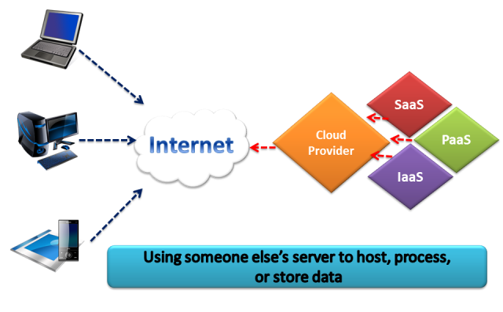
What is Cloud?

Slide 3
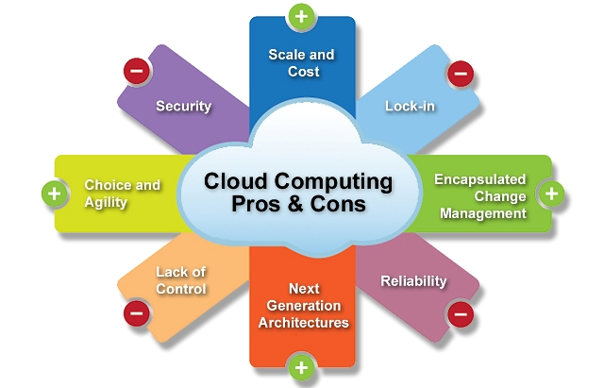
Pros and Cons

Slide 4
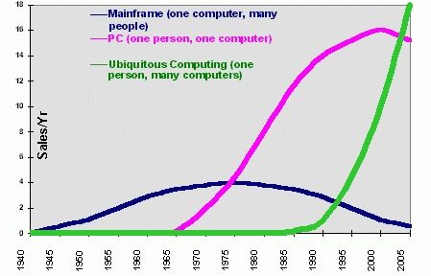
Trends in Computing
Centralized
Distributed Computing
Cloud Computing

Slide 5
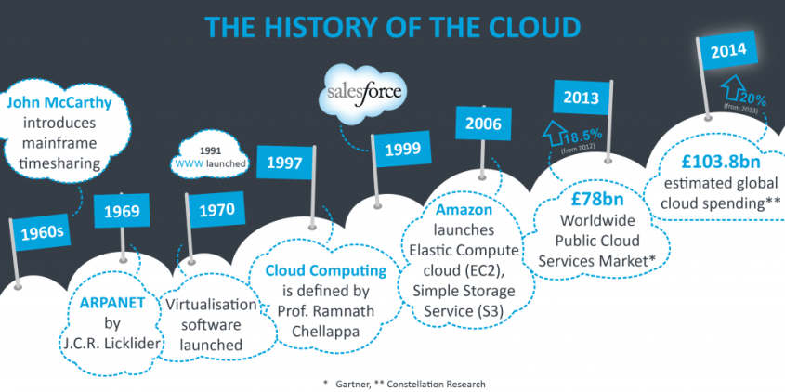
Evolution of Cloud Computing
Idea first came in the 1950s

Slide 6
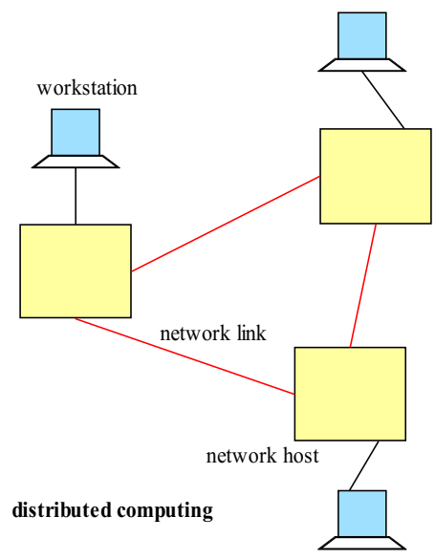
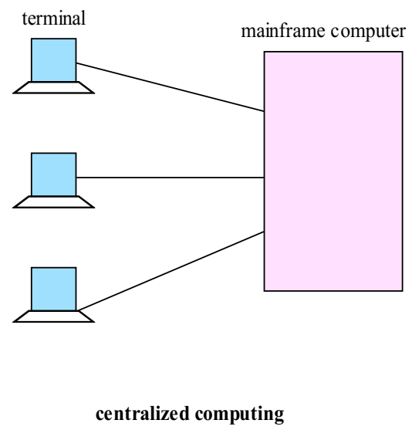
Centralized vs. Distributed Computing

Slide 7
Centralized vs. Distributed Computing
In a centralized system, there is a
Single component
Single point of control
Single point of failure
A distributed system is
A collection of independent computers, interconnected via a network,
Capable of collaborating on a tasks
Examples:
client-server
Peer to Peer

Slide 8
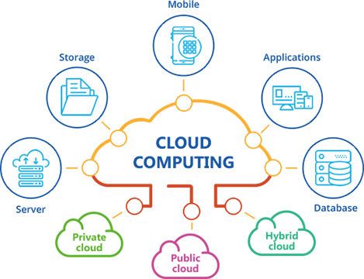
Cloud Computing
Model for enabling convenient and on-demand network access to a shared pool of computing resources e.g.
networks,
servers,
storage,
applications
Services
These resources can be rapidly provisioned and released with minimal management effort or service provider interaction

Slide 9
Essential Characteristics
On-demand self-service
A consumer can provision computing capabilities, such as server and network storage, as needed automatically without requiring human interaction.
Broad network access
Capabilities are available over the network
Resource pooling
The provider’s computing resources are pooled to serve multiple consumers
Measured Service
Resource usage can be monitored and controlled providing transparency.
Used for billing
Rapid elasticity
Scale rapidly outward and inward

Slide 10
Common Characteristics
Massive Scale
Resilient Computing
Geographic Distribution
Virtualization
Service Orientation
Low Cost Software
Advanced Security

Slide 11
Cloud Services Models
Software as a Service (SaaS)
e.g: Google Spread Sheet
Cloud Infrastructure as a Service (IaaS)
DigitalOcean
Azure
AWS
Platform as a Service (PaaS)
The consumer does not manage or control the underlying cloud infrastructure:
network, servers,
operating systems, or storage
Has control over the deployed applications and
Configuration settings

Slide 12
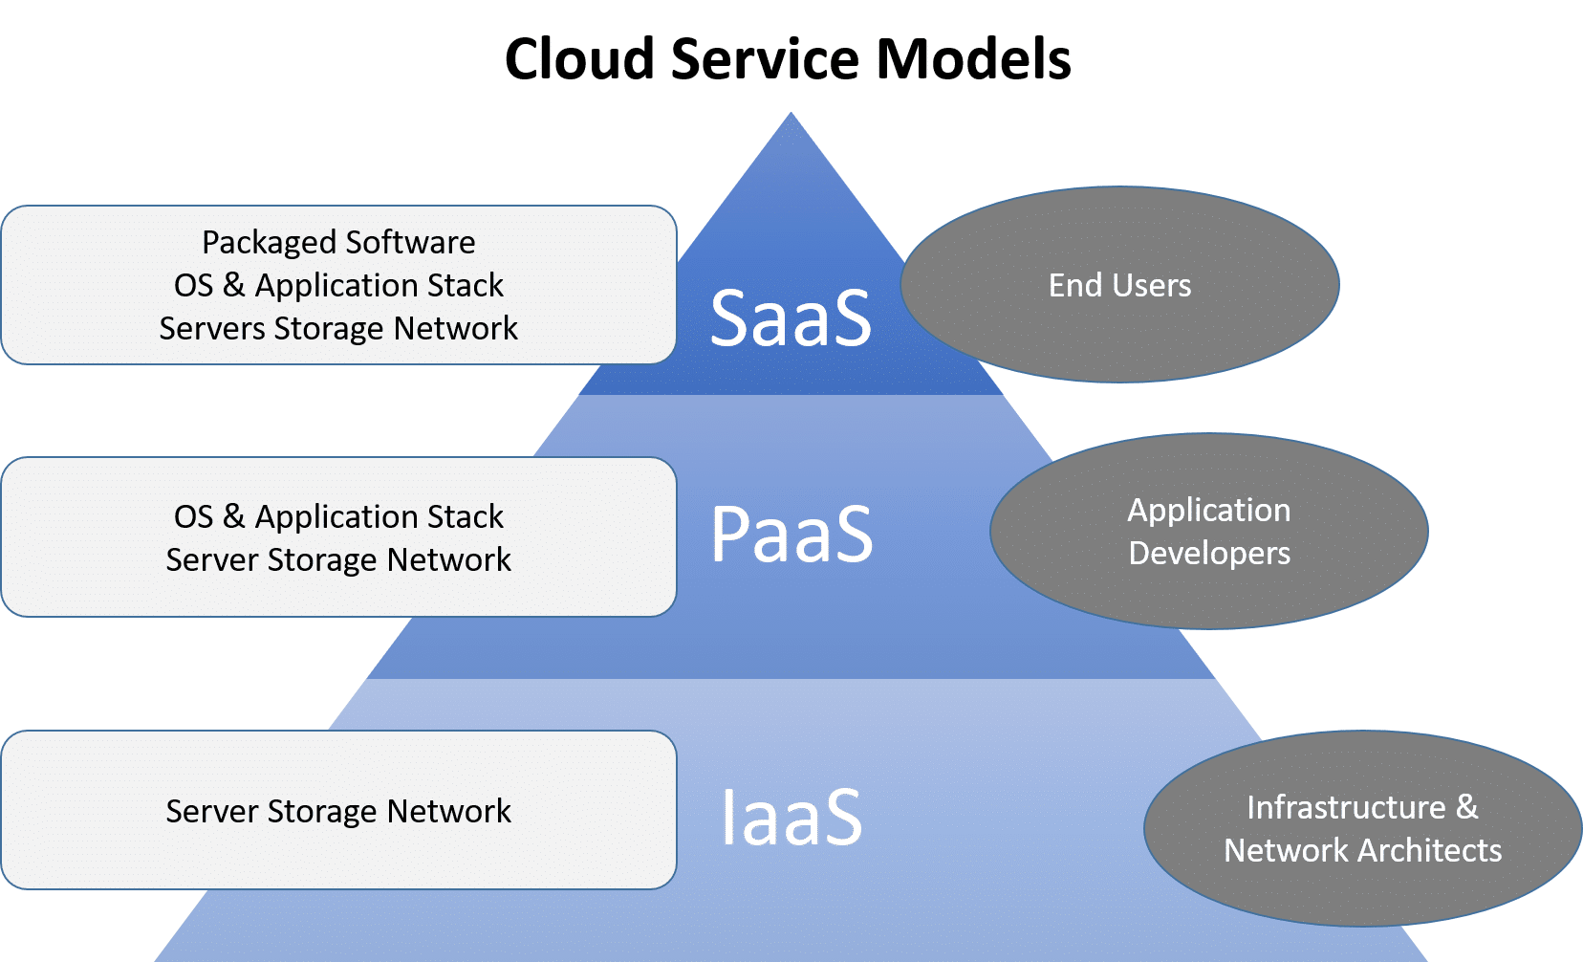
Cloud Services Models

Slide 13
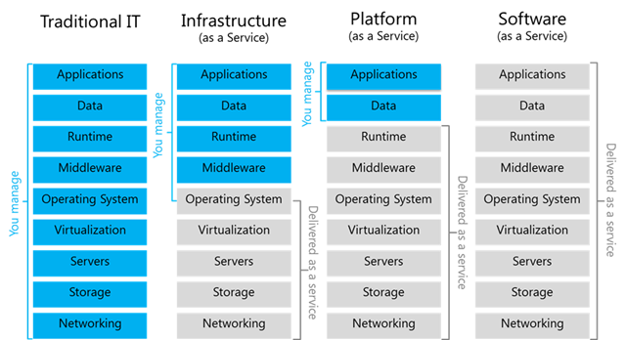
Cloud Services Models

Slide 14
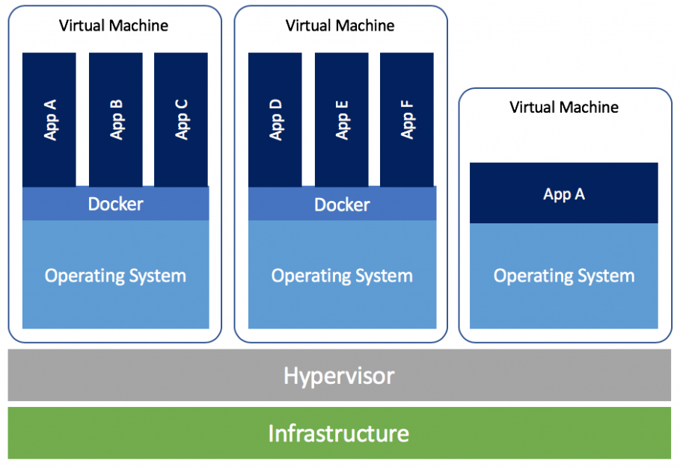
Virtual Machines
VM technology allows multiple virtual machines to run on a single physical machine

Slide 15
Top cloud applications
Mail and Messaging
Archiving
Backup
Storage
Security
Virtual Servers
CRM (Customer Relationship Management)
Collaboration across enterprises

Slide 16
AWS Services

Slide 17
Overview of Amazon Web Services
AWS (Amazon Web Services) is a Cloud Provider
In 2006, Amazon Web Services (AWS) began offering IT infrastructure services to businesses as web services
Now commonly known as cloud computing.
Today, AWS provides a highly reliable, scalable, low-cost infrastructure platform in the cloud
AWS powers hundreds of thousands of businesses in 190 countries around the world.
AWS powers some of the biggest websites in the world
Amazon.com
Netflix

Slide 18
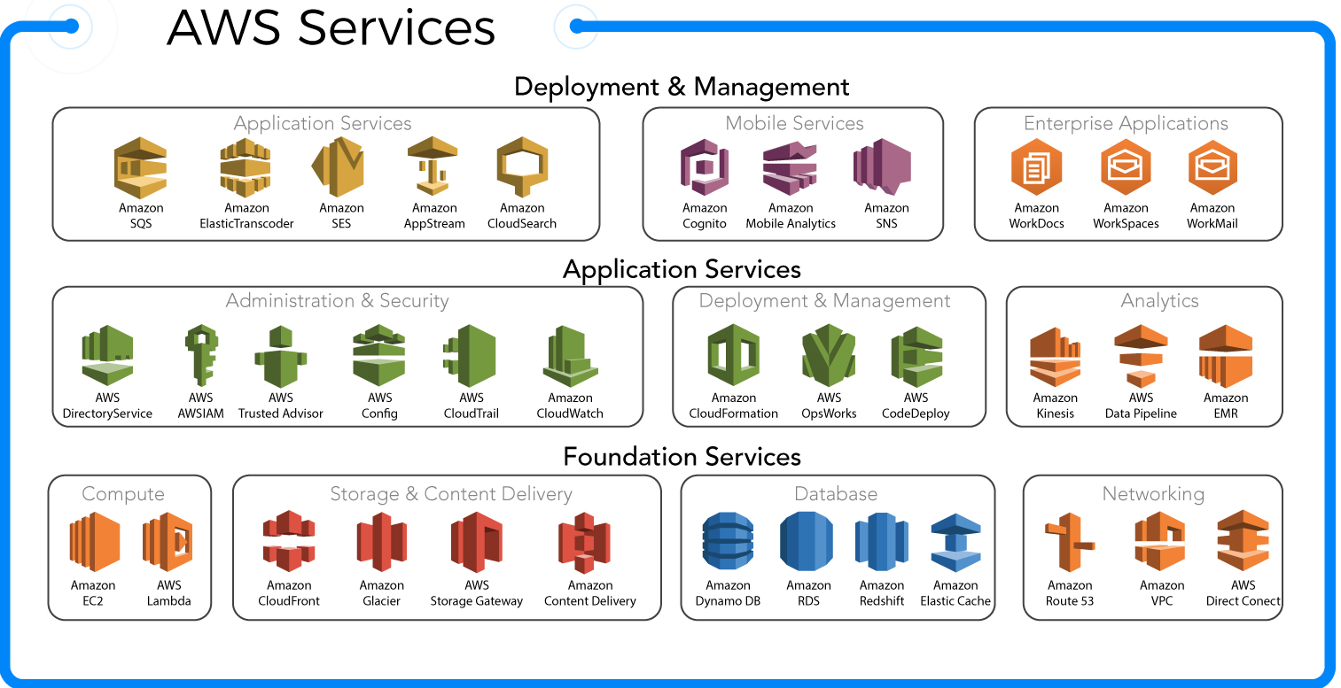

Slide 19
Hands-on: AWS Account Registration
Step 1 – Visiting the Signup Page:
https://aws.amazon.com/free/
Step 2 – Entering User Details
Step 3 – Filling up the Debit Card / Credit Card details
This will not charge anything from your account (except for a verification amount that will be refunded back)
Step 4 – Identity Confirmation
Need to select a mode to confirm your identity
It could be a Text Message or a Voice call to your valid phone number.
Step 5 – Selecting a Support Plan
Select Basic plan for free tier
Wait 10-15 minutes before the account can be activated. You will get e-mail
Login to the account

Slide 20
Hands-on: Understand the AWS Free Tier
Refer to below URL to understand what all services are free:
https://aws.amazon.com/free/?all-free-tier.sort-by=item.additionalFields.SortRank&all-free-tier.sort-order=asc

Slide 21
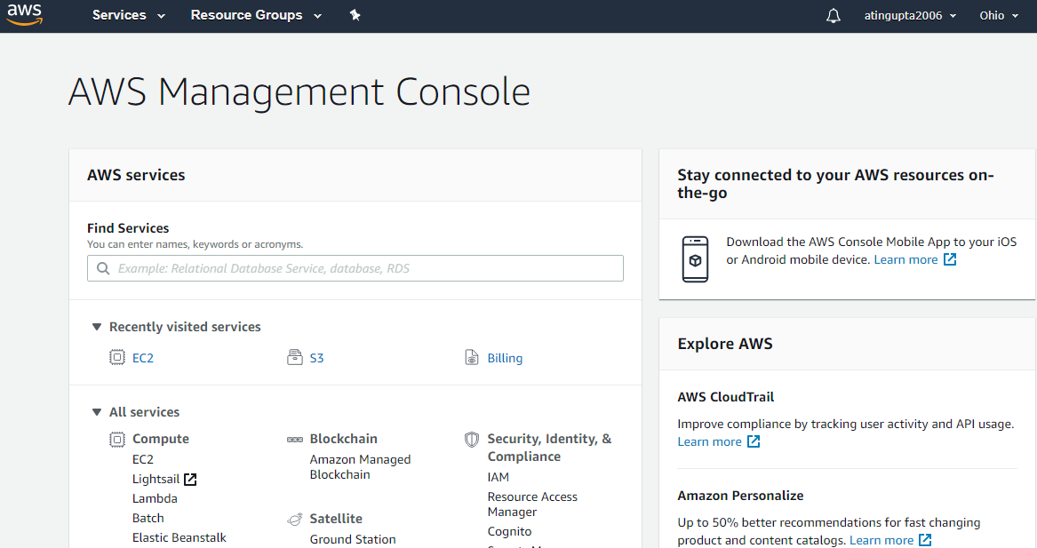
Hands-on: AWS Management Console Overview
A graphical interface used to interact with AWS services and features
Can manage all aspects of AWS services, as well as AWS account.
Notes:
There are several ways to find and open services that you need.
On the homepage you can:
Search for what you need,
Select recently visited services, or
Expand the All services section to browse through all of the AWS services.
The Services option is always displayed in the top navigation bar, allowing you to search for what you need at any time, list services by groups, or arrange alphabetically.

Slide 22
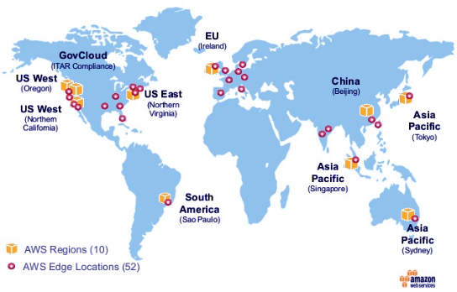
AWS Regions
AWS has Regions all around the world
A geographical location with a collection of availability zones
Mapped to physical data centers in that region.
Every region is physically isolated and independent
A region is a cluster of data centers

Slide 23
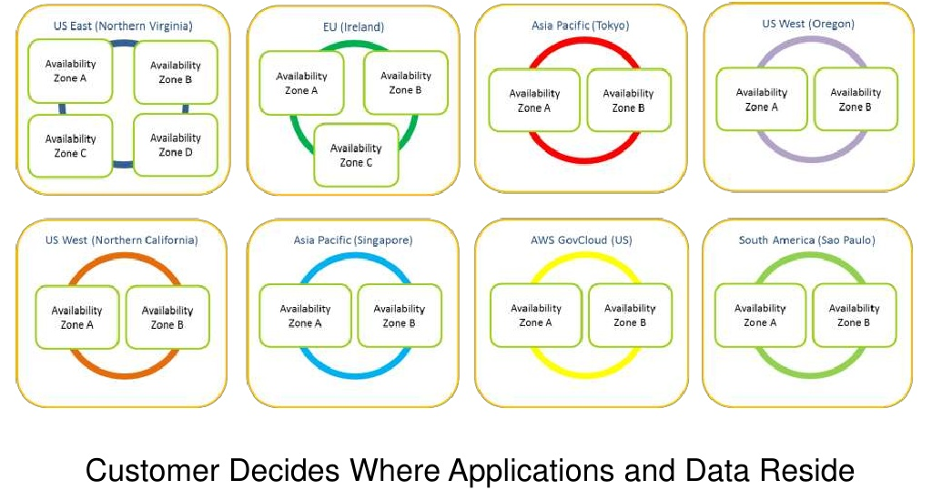
Region and Availability Zones

Slide 24
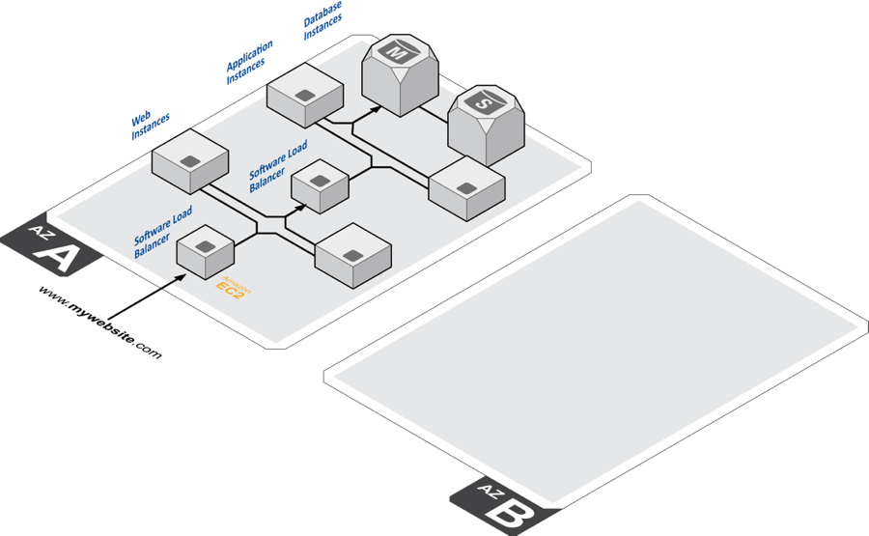
Availability Zones
Each region has many availability zones
(usually 3, min is 2, max is 6).
Example:
ap-southeast-2a
ap-southeast-2b
ap-southeast-2c
Inside each region, you will find two or more availability zones
Each zone hosted in separate data centers from another zone.
No two zones share a data center.
Underutilizing an AWS region with two availability zones.

Slide 25
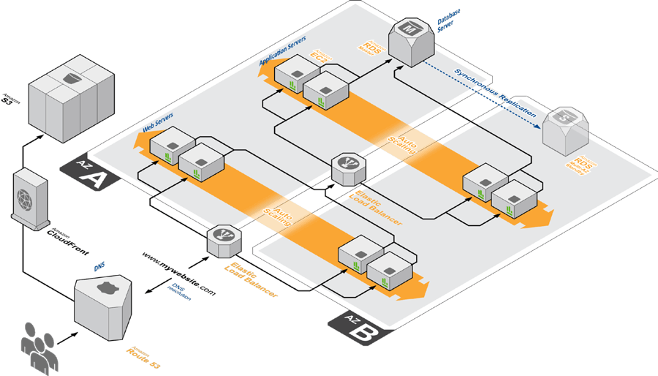
Availability Zones
A highly available application leveraging two Availability Zones.
This ability to leverage multiple zones is foundational for building a highly available, fault-tolerant application using AWS.

Slide 26
Reference – Regions and Zones
https://docs.aws.amazon.com/AWSEC2/latest/UserGuide/using-regions-availability-zones.html

Slide 27
AWS Pricing
AWS Pricing offers the most amazing options
You can rent a server for as low as 5$ a month!
AWS offers incredible free tier option

Slide 28

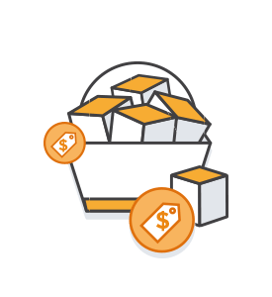
How does AWS pricing work?
Pay as you Go
AWS offers, pay as you go model, that is you only pay what you use.
Payless by using more
AWS bills you for the hour. The more AWS resources you use, the less the hourly rates become.
Save when you reserve
You can reduce your costs up to 75 percent when you use reserved instances compared to On Demand instances.

Slide 29
AWS Pricing Models
No Upfront
Don’t pay anything before you reserve the instance
But since there is no advance payment, the costs are higher than the other two options.
Partial Upfront
Pay a partial amount when you are reserving the instance
The costs in this model are lesser as compared to No upfront
Nut is still more expensive than full upfront
Full Upfront
Pay the whole amount when you are reserving the instance
The pricing is least in this case, since you are paying the full payment.

Slide 30
Hands-on: Calculate your savings
AWS offers two types of calculators for you to foresee what will be your expenses:
AWS Calculator
To calculate your monthly expenses
Can be used to foresee, what will be your expenditure if you use a certain set of resources
Provides templates
https://calculator.aws/
TCO (Total Cost of Ownership) Calculator
Used to compare one service’s price to another, or one infrastructure solution to the other
It matches your current infrastructure to the most cost-efficient AWS offerings.
https://aws.amazon.com/tco-calculator/

Slide 31
IAM Introduction
IAM (Identity and Access Management)
Your whole AWS security is there:
Users
Groups
Roles
Root account should never be used (and shared)
Users must be created with proper permissions
IAM is at the center of AWS
Policies are written in JSON (JavaScript Object Notation)

Slide 32
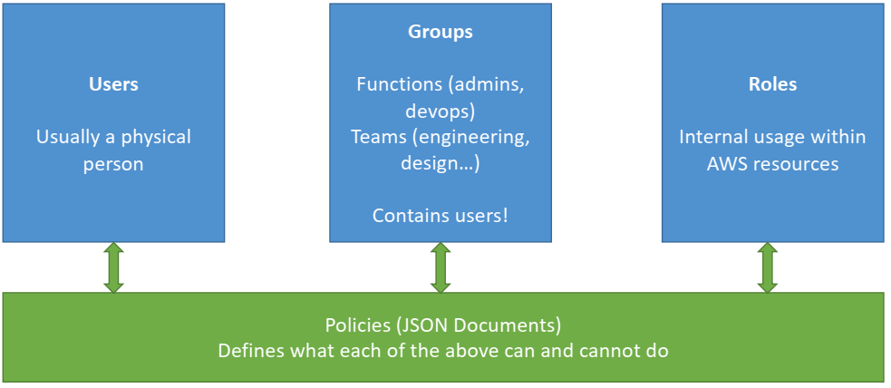
IAM Introduction

Slide 33
Thanks

